Slide 1






Introduction to Robotic Process Automation
AUTOMATION FOR
MICROSOFT REWARDS
220701515
Mohammed Rehan Sharief MT
Mr Duraiumurugan
Computer Science and Engineering

Slide 2
Abstract
This project presents an RPA-based system designed to automate Microsoft Rewards searches using UiPath and scrcpy. The system eliminates the need for manual input, leveraging UiPath’s powerful workflow automation capabilities to execute search queries and interact with the Microsoft Rewards app on an Android device mirrored through scrcpy. By automating repetitive tasks, the system significantly reduces the time and effort required for users to accumulate rewards points while ensuring consistent and error-free task execution.The proposed system operates through a structured process, starting with UiPath initiating the automation, interacting with the mirrored mobile device, executing predefined search workflows, and handling any errors through automated retry mechanisms.
Department of Computer Science and Engineering
Rajalakshmi Engineering College
2

Slide 3
Need for the Proposed System
The proposed system addresses the limitations of the manual process of earning Microsoft Rewards points, which is time-consuming, error-prone, and lacks scalability. Currently, users must perform repetitive tasks such as typing search queries, navigating app interfaces, and tracking their progress manually. This approach is inefficient, particularly for users managing multiple accounts or devices, as it requires significant time and attention. Additionally, human errors such as skipped searches, typographical mistakes, or incomplete tasks can lead to missed rewards and reduced efficiency.
Department of Computer Science and Engineering
Rajalakshmi Engineering College
3

Slide 4
Advantages of the Proposed System
Time Savings: The automation eliminates the need for manual searches, significantly reducing the time required to complete repetitive tasks. Users can accomplish in minutes what would otherwise take hours.
Error-Free Execution:By automating the entire process, the system minimizes human errors such as missed searches, typos, or skipped steps.
Increased Efficiency: The system performs tasks faster than manual methods, executing workflows in a streamlined and optimized manner.
Consistency in Task Completion: The automated workflows ensure that every search is performed uniformly, maintaining a high standard of execution across all tasks..
Department of Computer Science and Engineering
Rajalakshmi Engineering College
4

Slide 5
Main Objective
The main objective of the proposed system is to automate the process of performing Microsoft Rewards searches using UiPath and scrcpy, thereby eliminating manual effort, enhancing efficiency, and ensuring consistent task execution. The system aims to streamline repetitive tasks, reduce human errors, and maximize rewards accumulation by automating the end-to-end workflow, from search query input to results processing and reporting. Additionally, the system is designed to be scalable, handling multiple devices and accounts seamlessly, while providing users with a reliable, time-saving, and error-free solution for managing their rewards tasks effectively.
Department of Computer Science and Engineering
Rajalakshmi Engineering College
7

Slide 6
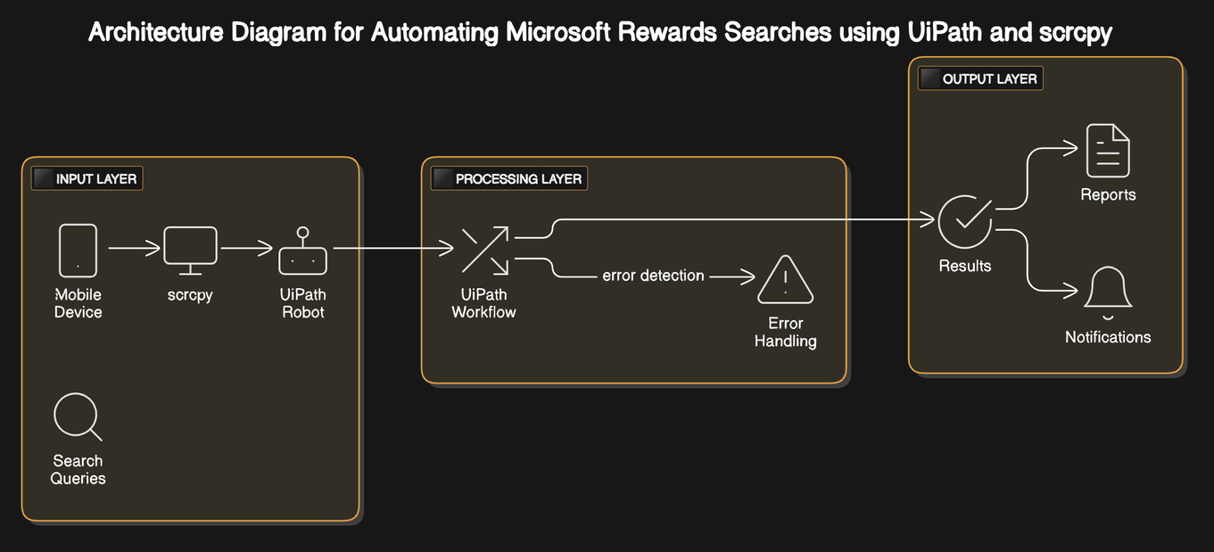
Architecture
Department of Computer Science and Engineering
Rajalakshmi Engineering College
8

Slide 7
System Requirements
Hardware Requirements
PC/Desktop:
Processor: Minimum Intel Core i5 or equivalent.
RAM: At least 8 GB (16 GB recommended for handling multiple tasks).
Storage: Minimum 256 GB SSD or HDD for storing logs, reports, and automation tools.
Display: 1080p resolution for clear interaction with scrcpy.
USB Ports: Required for connecting the mobile device to the PC for mirroring.
Mobile Device:
Android device with USB Debugging enabled.
Stable internet connection for performing Microsoft Rewards searches.
Network:
Reliable internet connection with speeds of at least 10 Mbps for both the PC and the mobile device.
Department of Computer Science and Engineering
Rajalakshmi Engineering College
9

Slide 8
System Requirements
Software Requirements
Operating System:
Windows 10/11 (64-bit) or Linux (if supported by UiPath and scrcpy).
UiPath Studio:
Version: Any recent version supporting automation workflows.
Required Packages: UiPath.System.Activities, UiPath.UIAutomation.Activities, UiPath.Excel.Activities (for reporting).
scrcpy:
Version: Latest stable version downloaded from GitHub.
Microsoft Rewards App:
Installed and configured on the Android device.
Active account for performing searches and earning points.
Driver Software:
Android USB drivers installed on the PC for scrcpy to recognize the device.
Dependencies:
ADB (Android Debug Bridge): Installed and configured for scrcpy.
.NET Framework: Latest version for running UiPath Studio workflows (if on Windows).
Tools for Reporting:
Excel (or an alternative spreadsheet application) for viewing or editing generated reports.
Email client or notification system for task alerts (optional).
Department of Computer Science and Engineering
Rajalakshmi Engineering College
9

Slide 9
Functional Description
Module 1: Data Extraction and Processing (For CineConnect Project)
In this module, the goal is to automate the extraction of movie booking details from user input and process it for storage and email communication. The process involves collecting relevant data like the movie title, selected seat, row, screen, and user email, and then validating and formatting this data to ensure it’s in the correct format for both Excel storage and email communication. Key tasks include:
Data Extraction: Collecting movie booking details such as the user's name, selected movie, seat, row, screen, and email from user input.
Data Validation: Ensuring the email entered is valid, specifically checking that it belongs to the college domain (e.g., "@rajalakshmi.edu.in"). Additionally, verifying that all fields (movie, seat, email) are filled correctly before proceeding.
Data Processing: Formatting the extracted data (e.g., ensuring the seat and row details are correctly structured), organizing it into an appropriate format for storing in an Excel sheet. The processed data will be stored in Excel and used for generating reports, calculating revenue, and sending email confirmations.
Department of Computer Science and Engineering
Rajalakshmi Engineering College
10

Slide 10
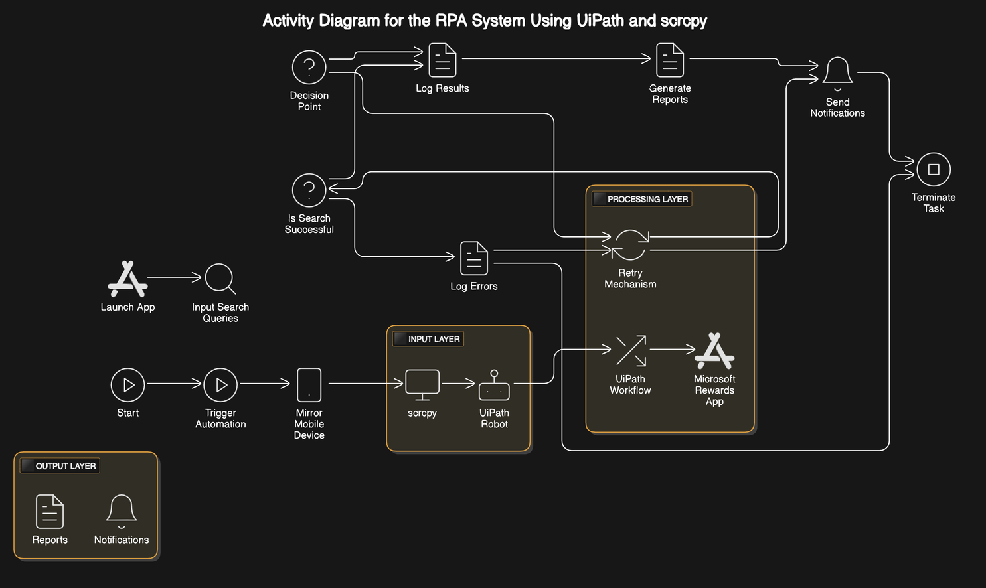
Functional Description
Activity Diagram
Department of Computer Science and Engineering
Rajalakshmi Engineering College
11

Slide 11
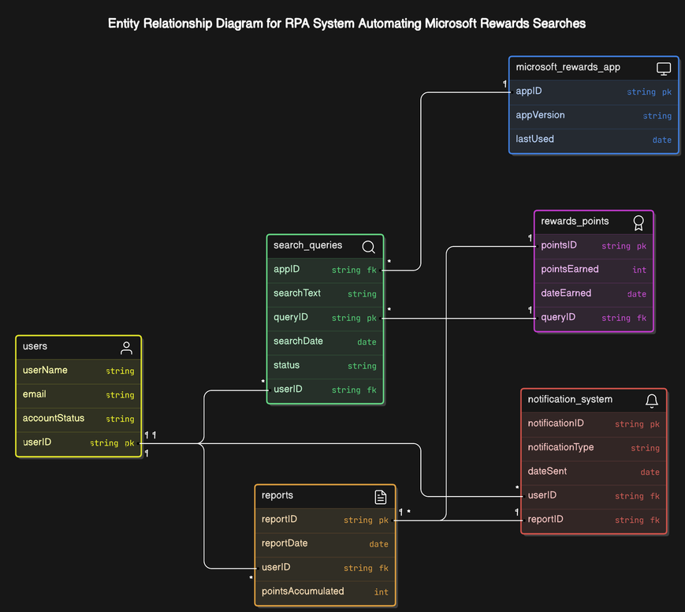
Table Design
Entity Relationship Diagram
Department of Computer Science and Engineering
Rajalakshmi Engineering College
14

Slide 12
Queries

Slide 13
Demonstration

Slide 14
Thank You

